Slide 1
Voice of Citizen
Under Guidance:
Mr.Sayeesh, Assistant prof.
Cse dept , AIET Mijar.
Project Mates:
Imran Khan
Manish B Shriyan
Vignesh Shetty
P Vighnesh Pejathaya

Slide 2
Introduction:
The proposed product provides the mobile application to raise complaint to the panchayat in which the citizen resides .
Also app platform for the Panchayat authorities to issue and solve the Complaint in prescribed amount of time Specified by GOV of India.
The main function of this system is to register complaint by taking the photo and uploading it with accurate location with tracking facility to their panchayat.
A new Android Platform is developed for panchayat with built in data and credentials by which they can resolve the problem of their area effectively.

Slide 3
The project includes three users of Application: citizen, panchayat and administrator.
Citizen: The citizen is the one who raises complaint .
Panchayat: Panchayat are the authorities who solve the problem addressed by the citizen.
Administrator: Administrator are the people who add new panchayat to the system and have all the rights on the system.

Slide 4
Problem Statement:
Though there is a method of registering complaint against water leakage, sewage, road or street light maintenance etc., they are done manually.
Nowadays due to the popularity of internet, many village panchayat has their own website in which the citizen can registers complaint.
But even though they use online web there are few disadvantages, such as difficulties in accessing, security issues and scalability.
So since Android is a versatile and easy platform an Application is developed to control and co-codinate all the processes for the smooth functioning of Panchayat Raj with Over all Development.

Slide 5
Literature survey:
Security Analysis of Mobile Device-to-Device Network Applications
Few data has ben collected and study has been performed to understand the security of application:
Smartphone have become the major part of human's life. Nowadays mobile applications are playing major role in many areas such as banking, social networking, financial apps, and entertainment and so on.
For every desktop or web application an alternate mobile app is available. With just single click number of mobile apps is available from Google's play market. With this huge number of applications securities is an important issue.

Slide 6
Many research articles discuss about the security of the applications and the malicious apps that may affect or leak sensitive data. As the android market is growing, security risk has increased and thus focus should be given to the few security Issues.
Hotspot without password absolutely unprotected.
Sensitive network information leakage .
Avoidable human-involved authentication process.
Insecure data transfer .
Mobile d2d network architecture and threat model are further explained in paper to be Published on the same.

Slide 7
Requirements Specification: Specification are derived from the Interaction and Requirements by Client:
In User Android Application:(Note all requirements are Updated unless underlined one)
Cancel Aadhar pic Upload Option.
Make Email optional.
Make User mobile/email as login Id.
Notification for Camera resolution to be more than 2MP while Capturing photo.
Send otp to mobile number in case of change in login credential.

Slide 8
Make photo visible or tick mark after uploading.
Add radio buttons for status of complaint, default pending, then either solved or rejected.
Write a note to upload genuine pic/complaint.
While user registers for complaint ask for phone number.
At splash page use a best tag line.
Description about the app.
Note: Use Gov India free Cloud Storage.

Slide 9
In Panchayat Application:
Remainder for not attending Complaint after 3 days.
Schedule for solving complaint should be removed.
After complaint is validated give buttons for only solved/rejected/default pending.
Phone number access for panchayat officer of the user who has registered the complaint.
Use pie chart instead of bar graph.

Slide 10
Make panchayat member login through ID’s provided to the respective Panchayats.
Completed task should be removed from completed columns
Provision to upload Pictures after completing the work.
“The android application should be developed for Panchayat members”

Slide 11
System Design: ER Diagram

Slide 12
Architectural Design:

Slide 13
Implementation:
Algorithm for Workflow of the Application
Step 1:
INPUTS: Gramlocation GL, FullName FN, MobileNumber MN, Email E, Password P, Gender G, Address A, UserPhoto UP, ComplaintPhoto CP, ComplaintLocation CL, ComplaintDescription CD
OUTPUT: Complaint registering Status.
Step 2:
if user not registered
then RegisterUser ( GL, FN, MN, E, P, G, A, UP )
else LoginUser ( E/MN, P )
display panchayat information
end if

Slide 14
Step 3:
number_of_complaints = 0
choose complaint domains {ex water, sewage, streetlight, road ,……}
Step 4:
for each complaint domain chosen do
RegisterComplaint ( CP, CL, CD )
number_of_complaints++
CheckComplaintStatus( )
end for

Slide 15
Algorithm for Register User
Step 1:
INPUTS: Gramlocation GL, FullName FN, MobileNumber MN, Email E, Password P, Gender G, Address A, UserPhoto UP
OUTPUT: User registration successful or not
Step 2:
if connection established
then move the user information into the database retrieve user information during profile view
else throw exception
end if

Slide 16
Algorithm for Login User
Step 1:
INPUTS: Email E,MobileNumber MN, Password P
OUTPUT: User logged in successfully or not
Step 2:
if connection established
then compare the credentials with the database
if comparison is equal to zero
then login successful
else invalid credentials has been entered
end if
else throw exception
end if

Slide 17
Algorithm for Register Complaint
Step 1:
INPUTS: ComplaintPhoto CP, ComplaintLocation CL, ComplaintDescription CD
OUTPUT: Complaint registered successfully or not
Step 2:
if complaint not registered already
then capture the photo using the phone camera
get the location using gps
enter the description regarding the complaint
else complaint will not be registered
end if

Slide 18
Algorithm for CheckComplaintStatus
Step 1:
INPUT: Complaint ID
OUTPUT: Complaint accepted or rejected
Step 2:
if all the necessary details provided
then show the complaint as accepted
Generate auto date to solve Complaint issued
else show the complaint as rejected
provide the reason for rejection
end if

Slide 19
Testing:
Software testing is defined as an activity to check whether the actual results match the expected results and to ensure that the software system is defect free.
Software testing also helps to identify errors, gaps or missing requirements in contrary to the actual requirements.
There are different levels of testing to detect different types of errors which include unit testing, integration testing and system testing which are done once Complete Application is available before deplovement.

Slide 20
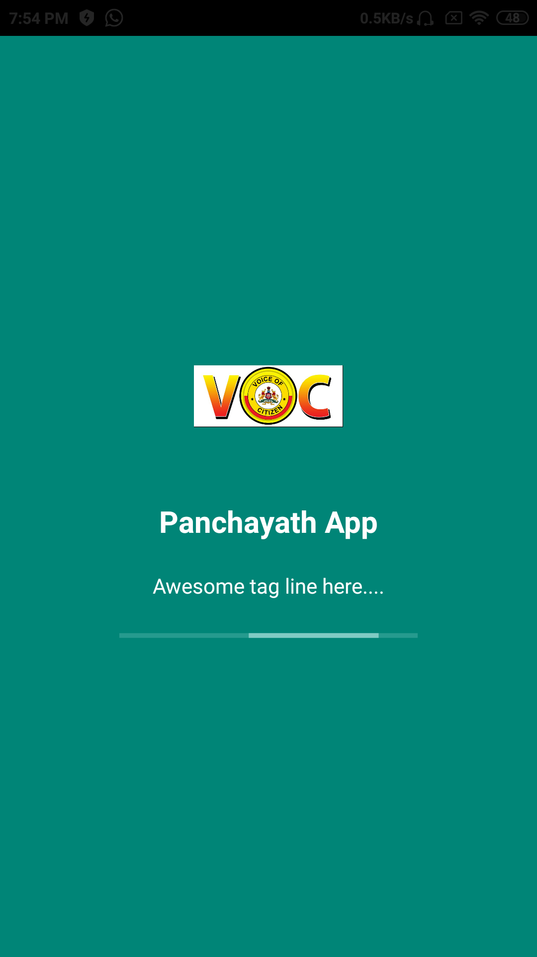
Sample Output:
Fig 1:Splash Page of Panchayat Application

Slide 21
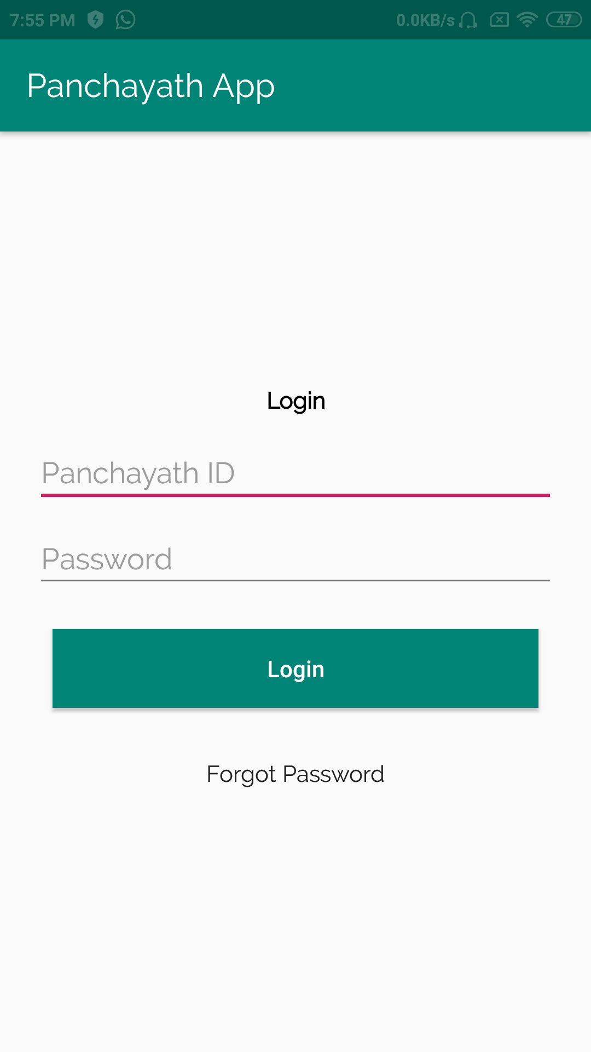
Fig 2:Login Page

Slide 22
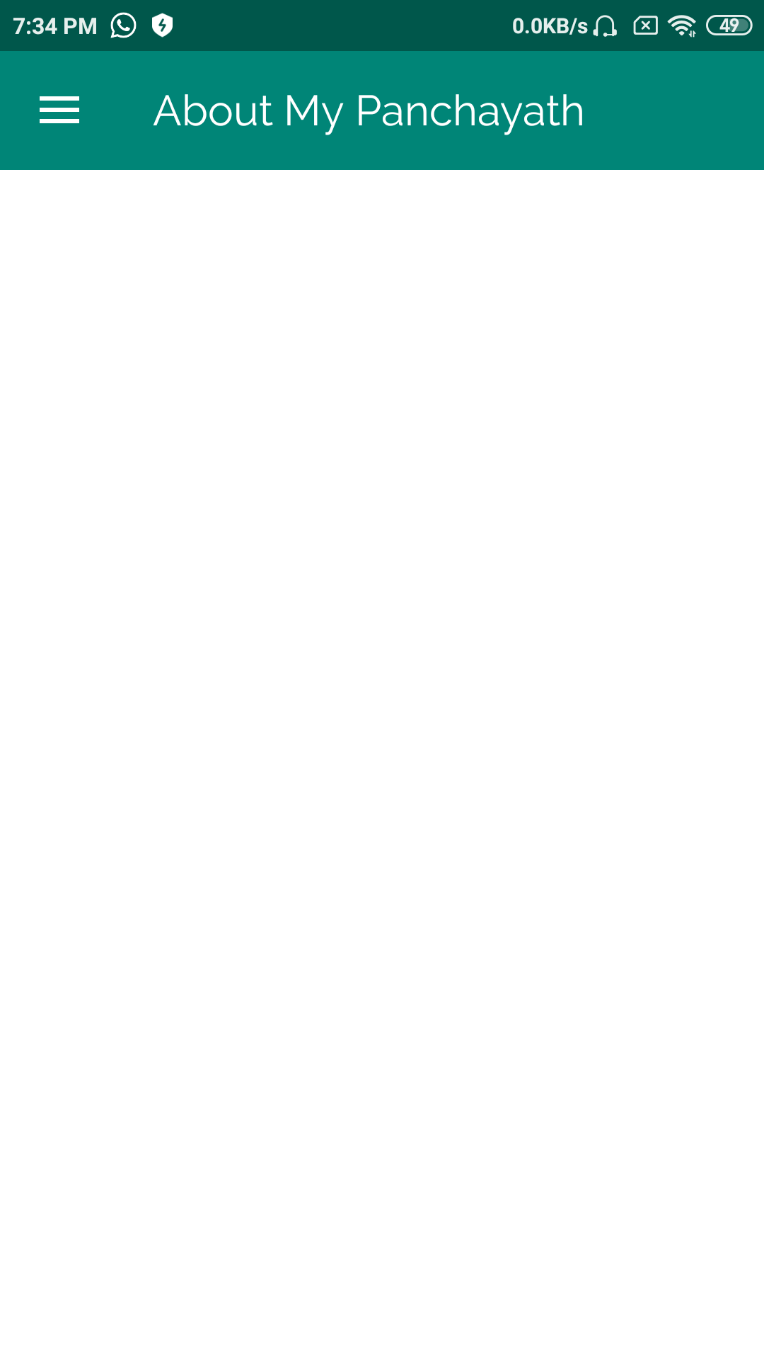
Fig 3:About Panchayat Details

Slide 23
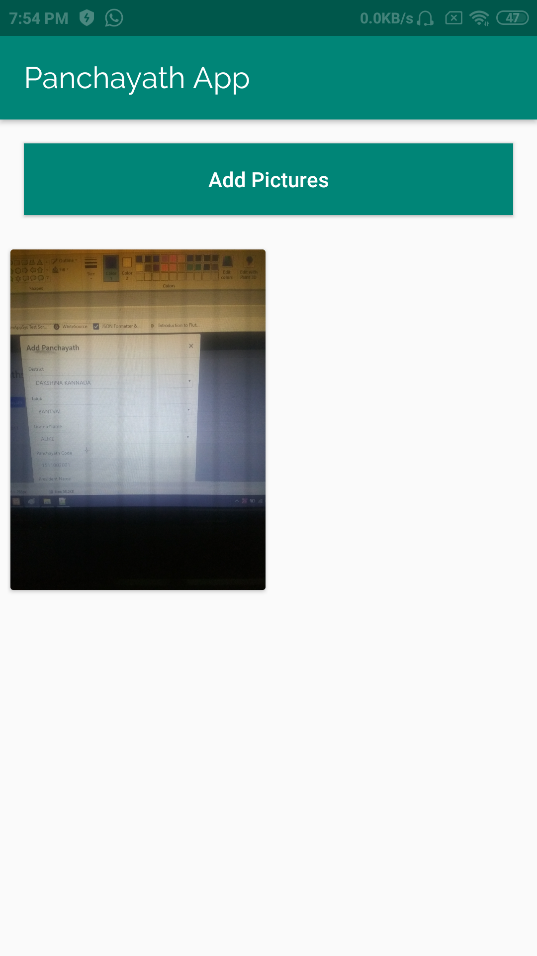
Fig 4:Adding images by Panchayat

Slide 24
Publication Details
A review paper on the basis of Android security “Review on Android Application Security“ is been done in order to support the working of the Application.
The paper deals with the basic principles and security concerns of any android Application and an algorithm based on Encryption and Decryption “AES (Advanced Encryption Standards) “
It is planned that the paper is to be published in the International Journal of Computer(IJC) by the end of this week.

Slide 25
References
Fei Shao, Zinan Chang, Yi Zhang, “AES Encryption Algorithm Based on the High Performance Computing of GPU,” Second International Conference on Communication Software and Networks, 2010.[Date of access: 20 August 2015].
Abhishek Vichare and Tania Jose, Jagruti Tiwari, Uma Yadav , “Data Security using Authenticated Encryption and Decryption Algorithm for Android Phones”, International Conference on Computing, Communication and Automation (ICCCA2017)
Karthick S, “Android Security Issues and Solutions”, International Conference on Innovative Mechanisms for Industry Applications(ICIMIA 2017)

Slide 26
Thank you

